Slide 1
Multiple Exposure

Slide 2
For this assignment you will need to shoot new images and produce two mounted prints.
The main thrust of this assignment is to produce imagery that is made of more than one single exposure. There are a number of ways to achieve this technically. These are some of your options:
1) You may mount more than one photograph on your mounting surface, i.e. a diptych, triptych, collage/montage or even your contact sheet. You may choose to produce a sequence of images that reads a narrative. You may simply choose to mount more than one photograph on your mount as comparison /contrast which is either a visual or intellectual juxtaposition.
2) Another method you could use would be to combine images on the computer. This can be immensely complicated or rather simple. I would keep things simple this first time out. You can do "Uelsmann" like images by adding images via layers and making parts of those layers transparent so that other things show through.
I want to remind you that this assignment is not about technique though it may have that appearance. It is simply a means to an end. You should be thinking about how all of your imagery works with one another. It is easy to get caught up in the excitement of making something that looks different but that excitement will not last for very long if the images are inherently meaningless. Last but not least, I want you to have some fun with this assignment. Be open-minded and you might be surprised at the images that you come up with.

Slide 3
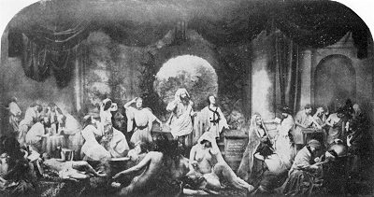
Oscar Rejlander

Slide 4
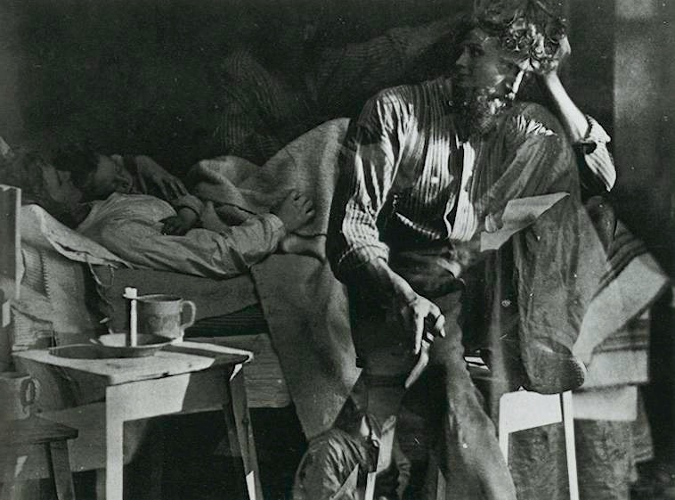
Oscar Rejlander

Slide 5
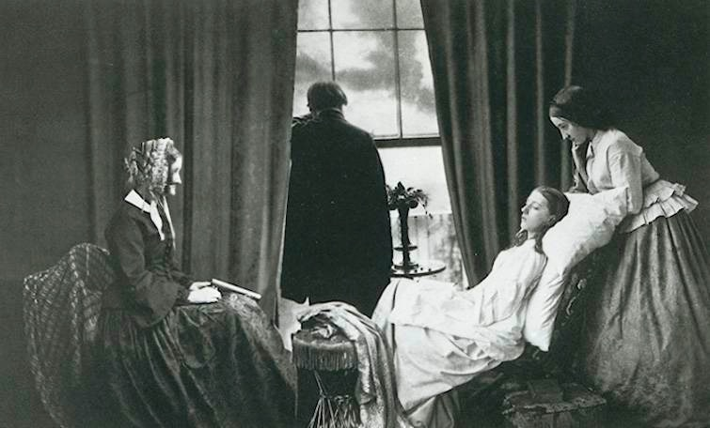
Henry Peach Robinson

Slide 6
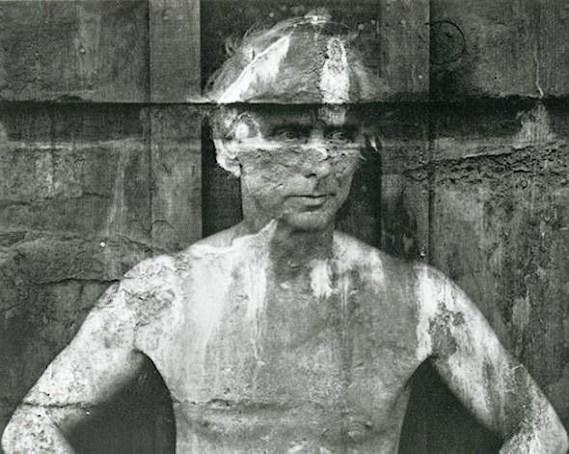
Fredrick Sommer

Slide 7
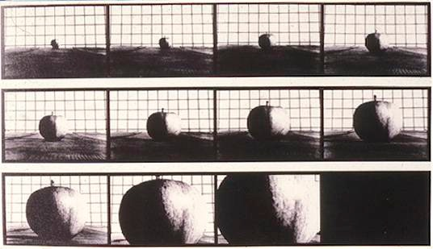
Hollis Frampton and Marion Faller

Slide 8
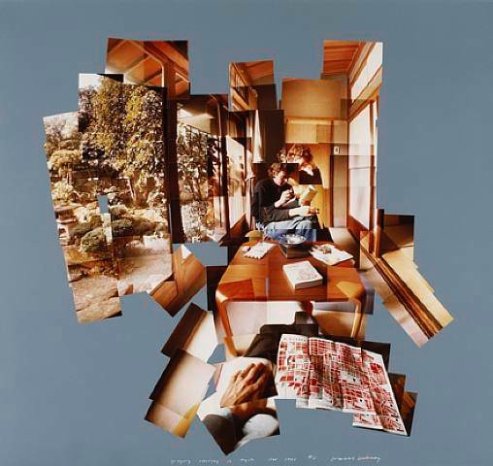
David Hockney

Slide 9
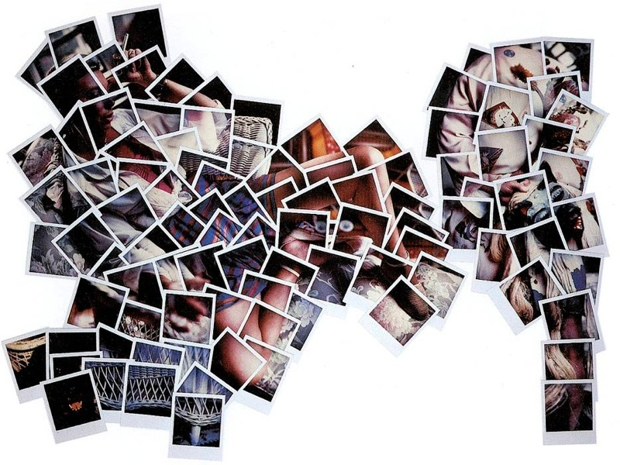
Joyce Neimanas

Slide 10
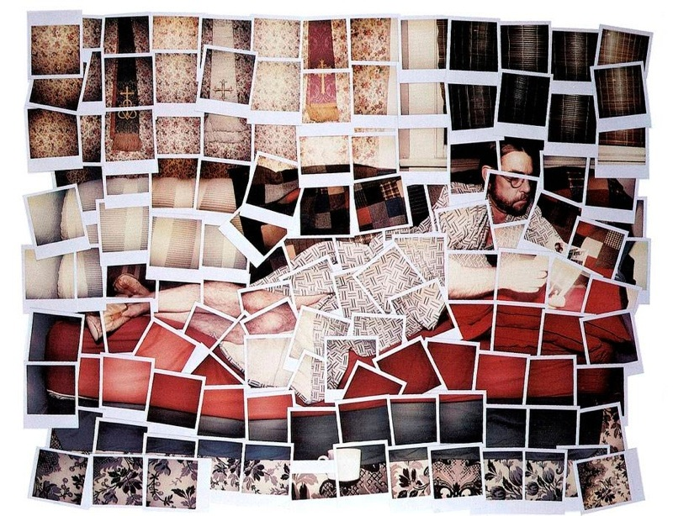
Joyce Neimanas

Slide 11
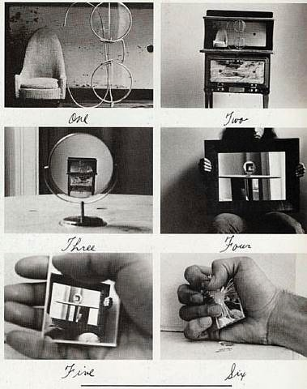
Duane Michals

Slide 12
Duane Michals

Slide 13
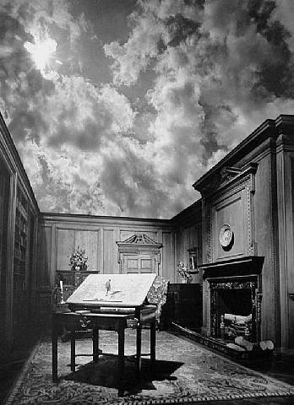
Jerry Uelsmann

Slide 14
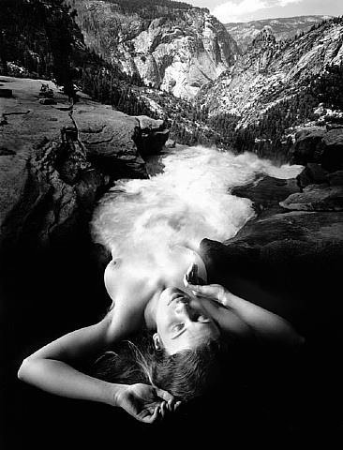
Jerry Uelsmann

Slide 15
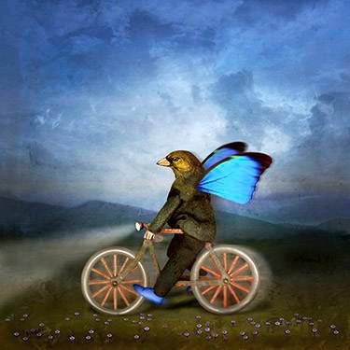
Maggie Taylor

Slide 16
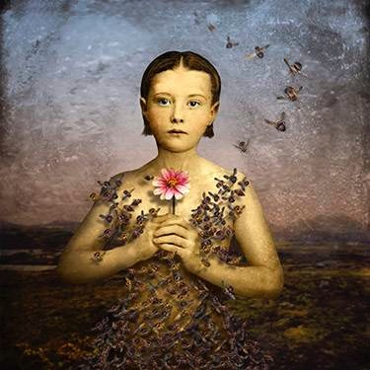
Maggie Taylor

Slide 17
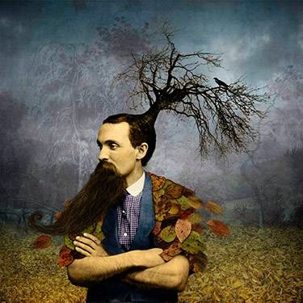
Maggie Taylor

Slide 18
Student Examples

Slide 19
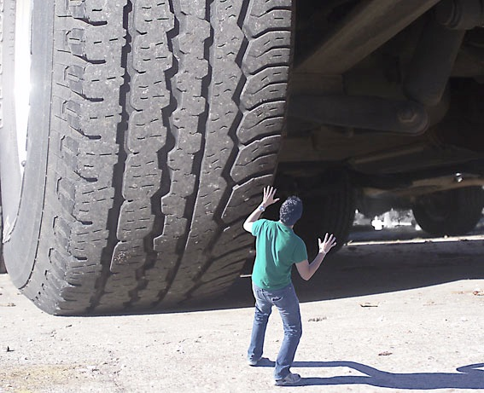

Slide 20
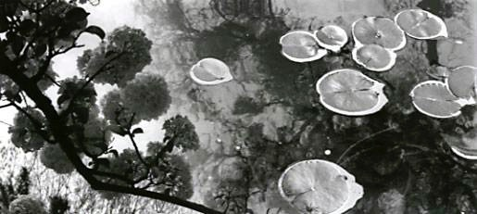

Slide 21
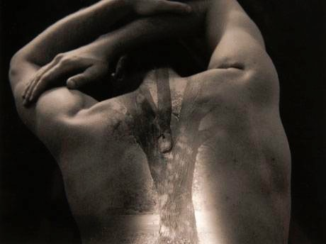

Slide 22
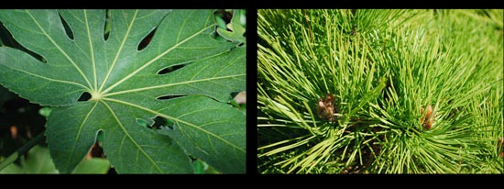

Slide 23
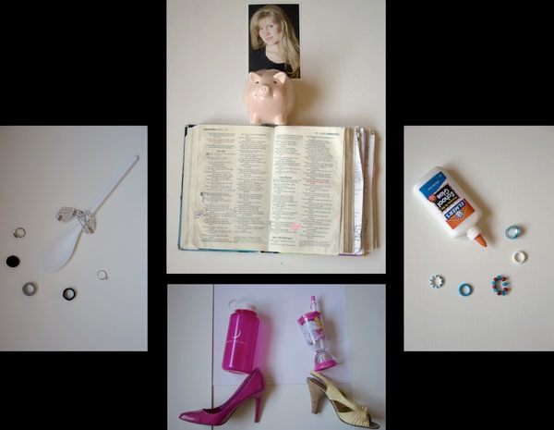

Slide 24
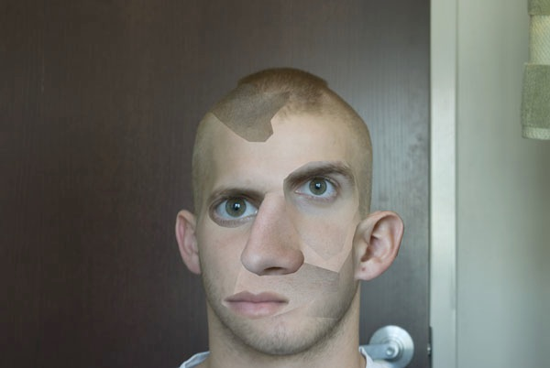

Slide 26
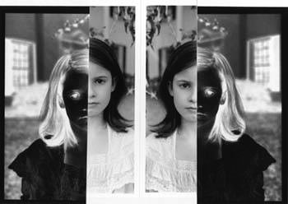

Slide 27
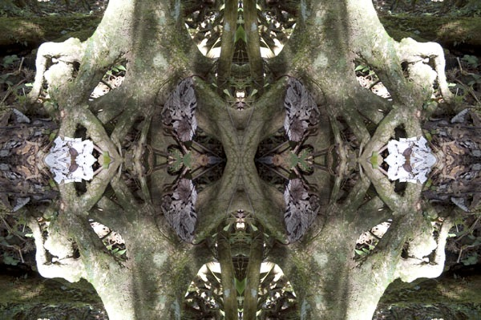

Slide 28
